Slide 1
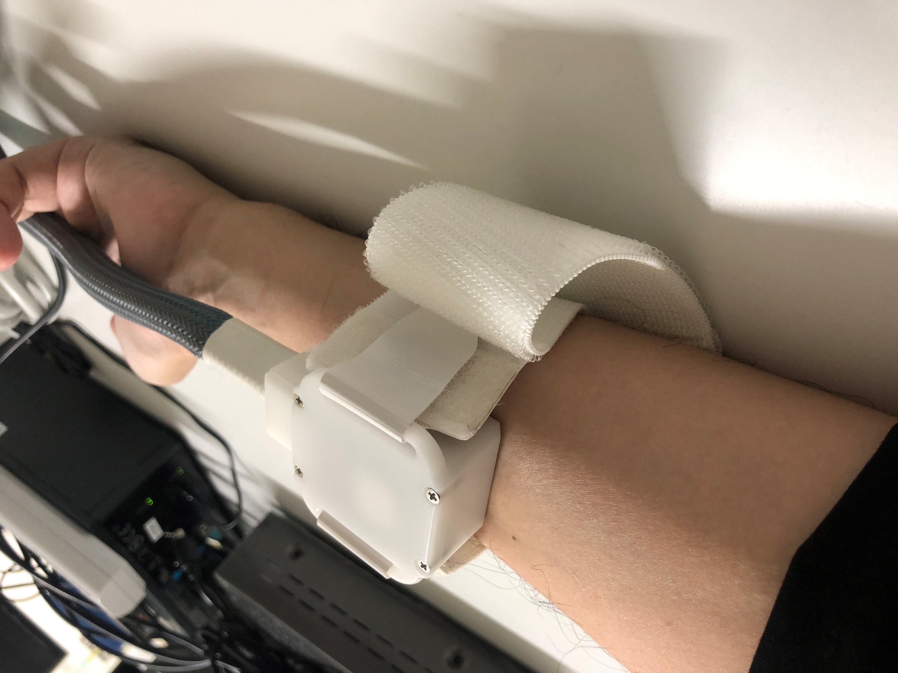

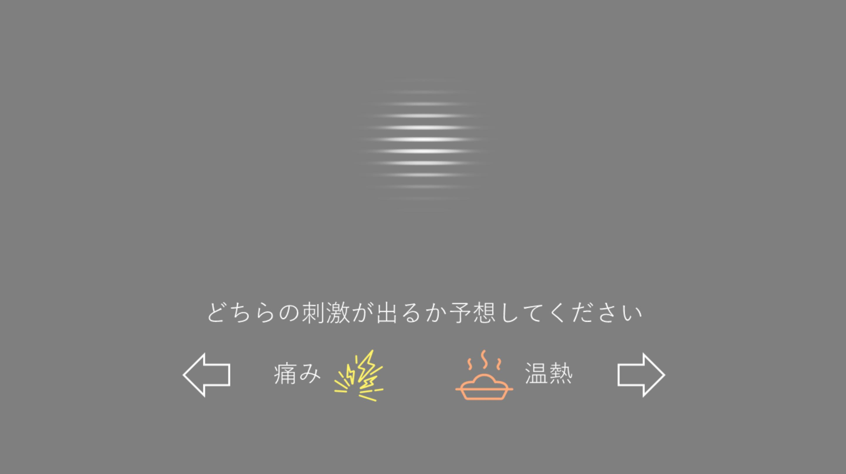
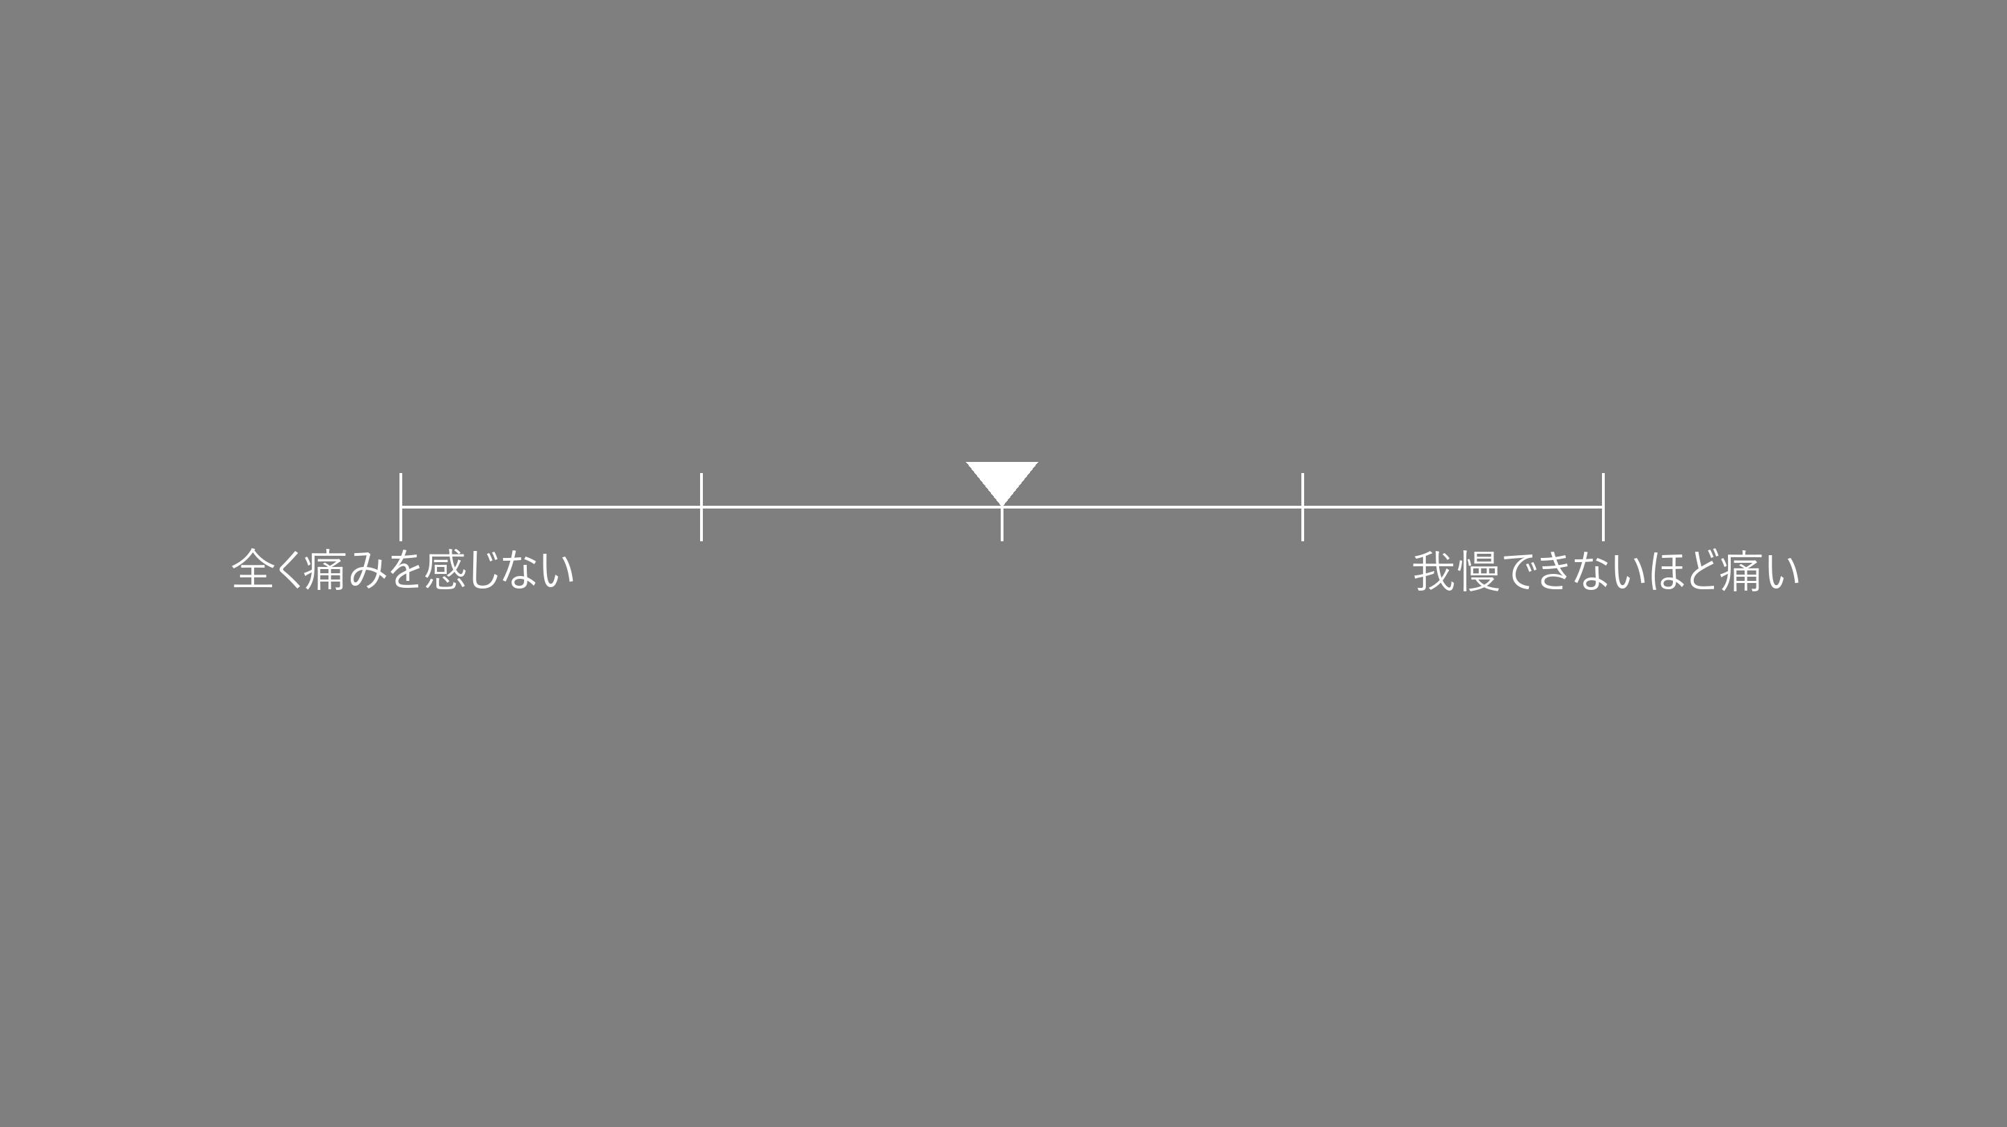
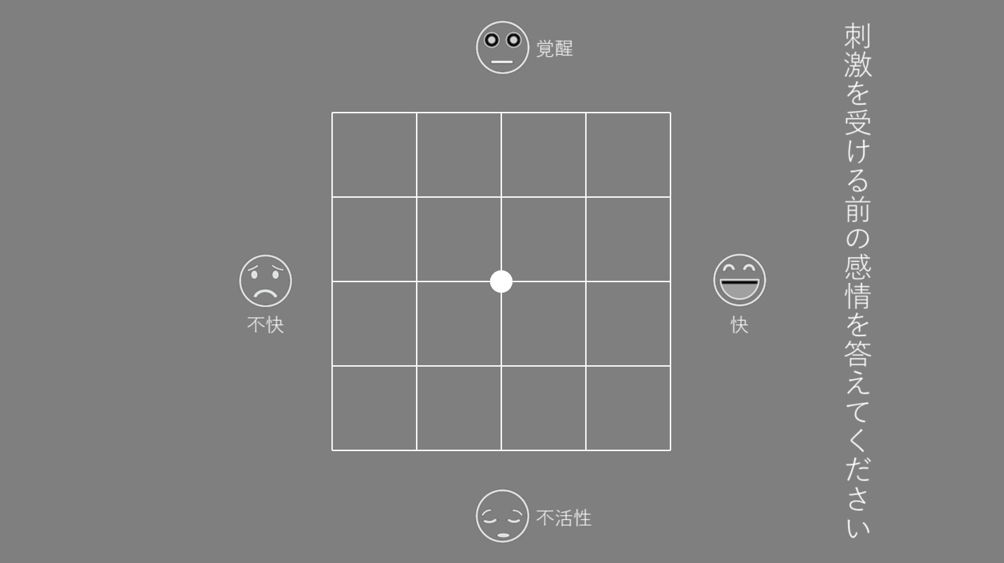
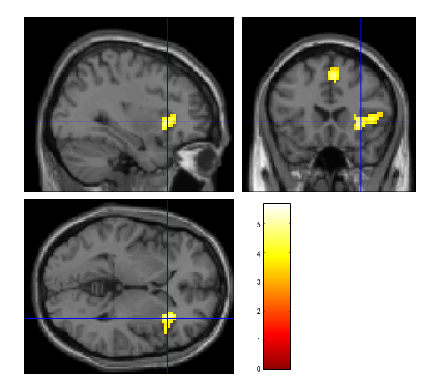
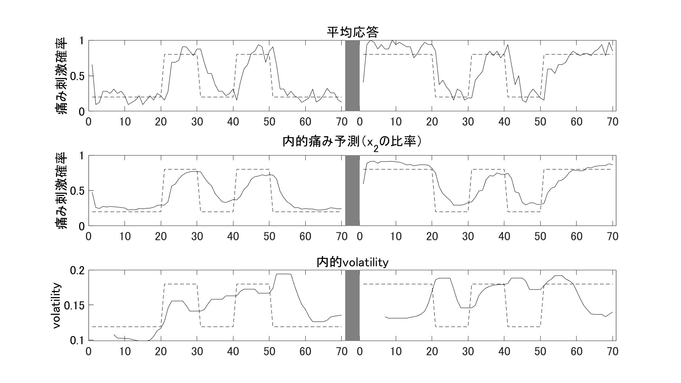

80% 痛み
20% 温熱
Cue A
20% 痛み
80% 温熱
Cue B
$$volatility≜x_{2}\left(1−x_{2}\right)∙exp\left(x_{3}\right)$$
SMC
0.5s
3.0s
~1.0s
3.0s
5.0s
~2.5s
~3.5s
固視点
Cue
痛み予測
予期
痛み刺激
痛み評定
感情評定
aIns
uncorr. p < 0.001 at peak level
FWE p < 0.05 at cluster level

